Slide 1
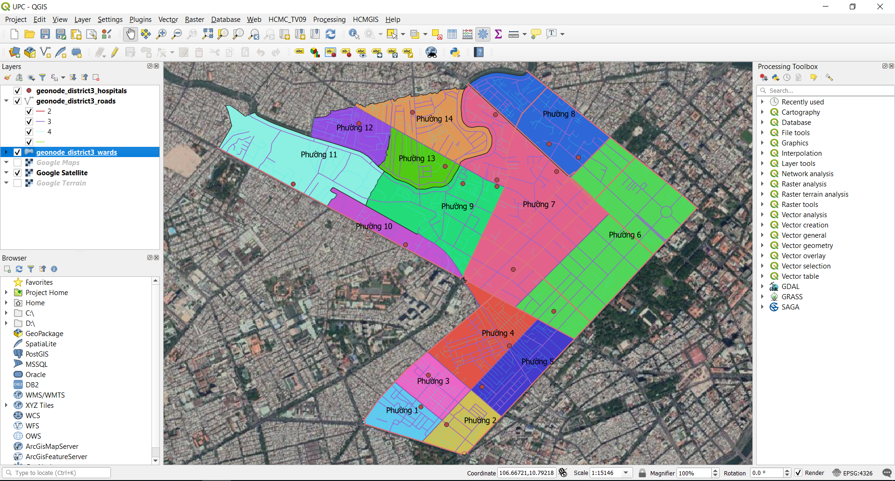
Unit 5: Editing Vector Layers and Print Layout Composer

Slide 2
Editing Vector Layers
Editing mode (Toggle Editing)
Add new feature (point, line, polygon)
Edit existing features (point, line, polygon)
Snapping option
Copy and Paste when editing
Advanced Digitizing Toolbar
Shape Digitizing Toolbar

Slide 3
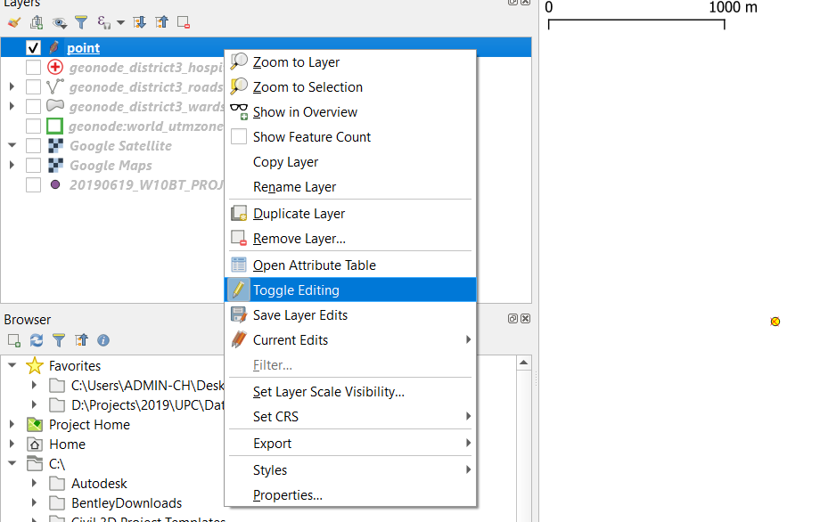
Editing Vector Layers
Toggle Editing: Enable/ Disable Editing mode (for both geometry and attribute editing)
Remember to Save Layer Edits

Slide 4
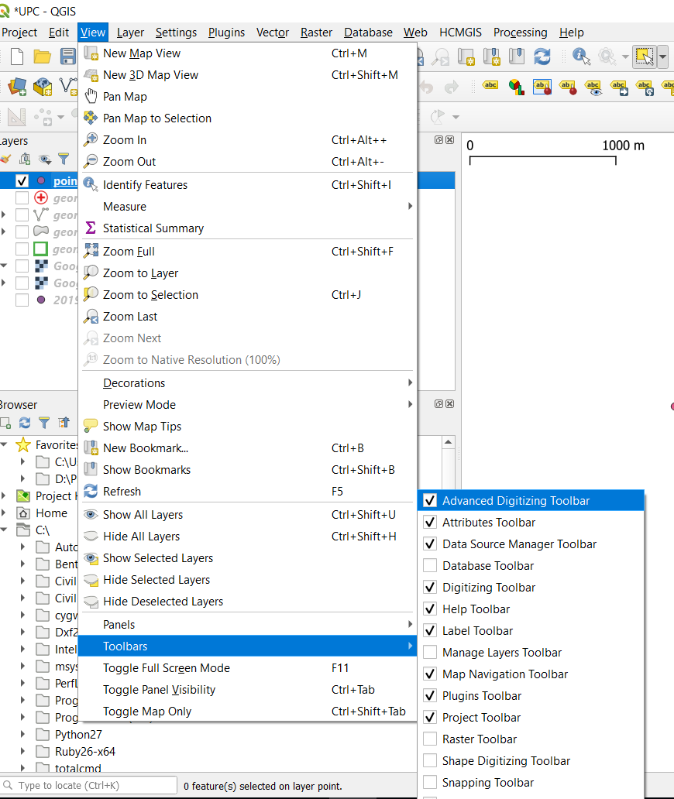
Editing Vector Layers
Undo (Crtl+Z), Redo Edits (Crtl+Shift+X)
Advanced Digitizing Toolbar: View → Toolbars
Shape Digitizing Toolbar: draw regular shapes and curved geometries.

Slide 5
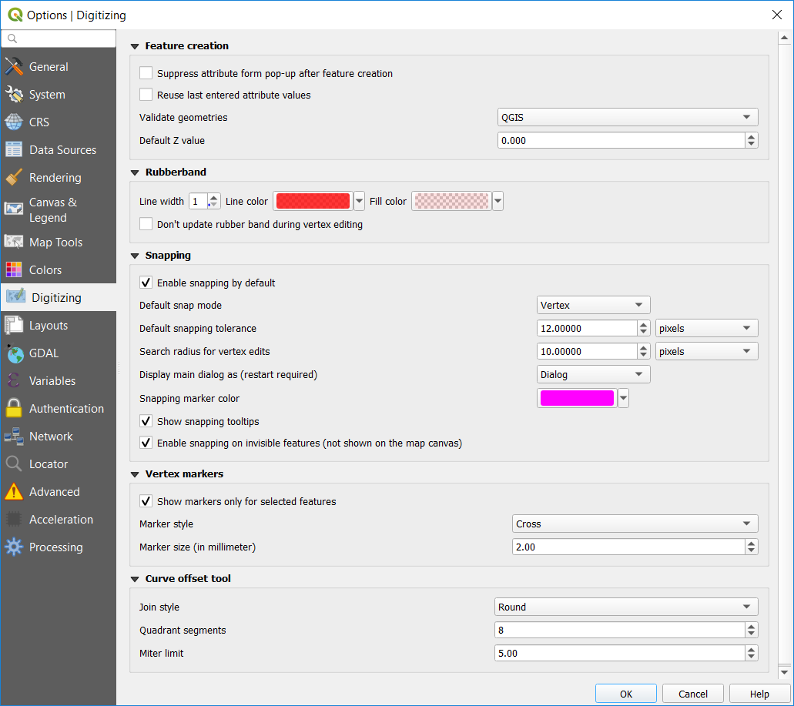
Snapping option
Option → Digitizing → Enable Snapping by default
View → Toolbar → Snapping Toolbar

Slide 6
Editing Vector Layers
Advanced Digitizing:
Move/ Copy and Move features
Rotate feature
Simplify Feature
Add ring/ Fill ring/ Delete ring (Polygon feature)
Add part/ Delete part
Reshape feature
Offset Curve
Split feature
Split parts
Merge selected features
Merge attribute of selected features

Slide 7

Editing Vector Layers
Shape Digitizing Toolbar: draw regular shapes and curved geometries.
Add Circular String
Add Circle from 2 or 3 Points
Add Circle from by a Center Point and Another Point
Add Ellipse from Center and a Point/ 2 Points
Add Ellipse from Extend
Add Ellipse from Foci (2 Focus)
Add Rectangle from Center and a Point
Add Rectangle from Extend
Add Rectangle from 3 Points
Add Regular Polygon from 2 Points
Add Regular Polygon from Center and a Point
Add Regular Polygon from Center and a Corner

Slide 8
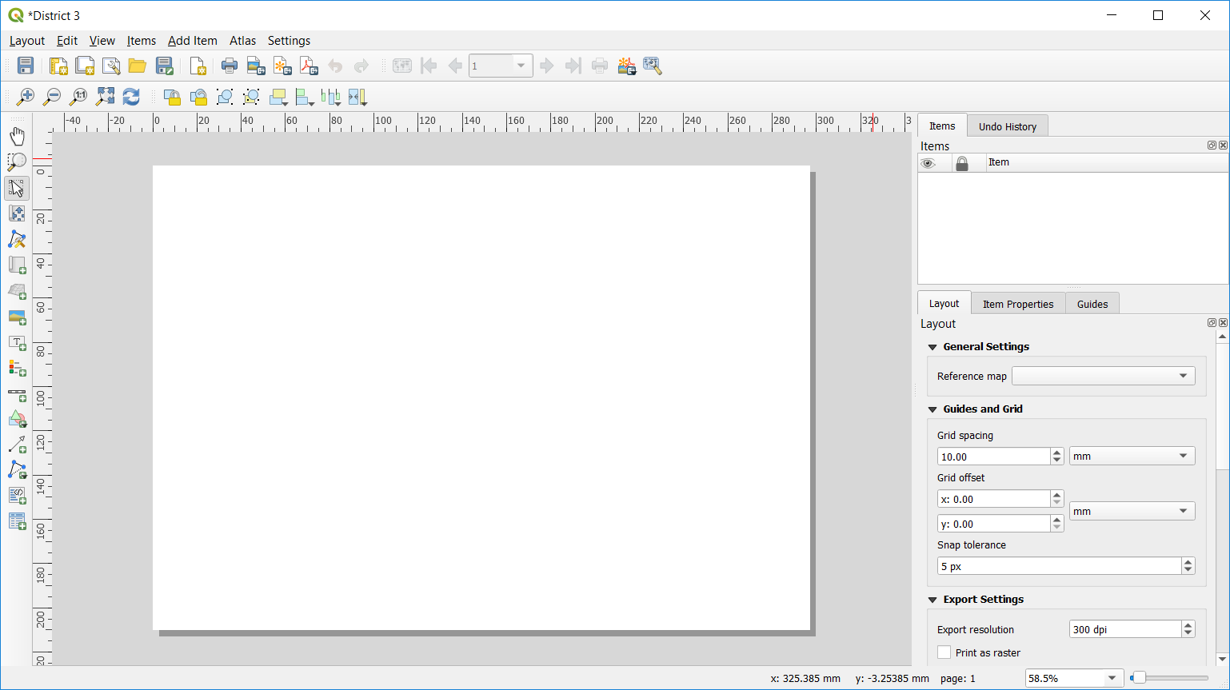
Print Layout Composer
Project → New Print Layout

Slide 9
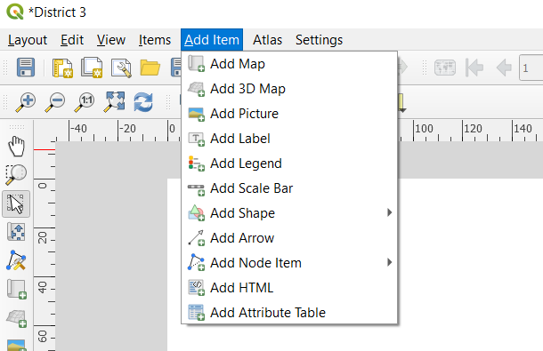
Print Layout Composer
Add Map/ Picture/ Label/ Legend/ Scale Bar to Print Layout
Page Properties: Choose page size and orientation (landscape or portrait)

Slide 10
Keep Calm and enjoy Learning!
https://hcmgis.vn
HCMGIS – GIS for the City, GIS for the Community

